Slide 1
Motion in One Dimension
Examples in the real world?
Why do we start with motion in one dimension?

Slide 2
Motion takes place over time and depends upon a frame of reference.
You are on a train traveling at 90 km/h. You toss a ball forward on the train. It moves away from your hand at 40 km/h. What is the velocity of the ball at the moment you release it?
You are in a car traveling at 90 km/h. You put your hand out of the window release a ball. What is the velocity of the ball at the moment you release it?

Slide 3
Displacement
As an object moves from one position to another, the length of the straight line drawn from its initial position to its final position is called the displacement of the object.
Displacement is a change in position.
$$∆x=x_{f}−x_{i}$$
Displacement equals final position minus initial position

Slide 4
Displacement is
Not always equal to distance traveled – path independent.
Positive or negative.

Slide 5
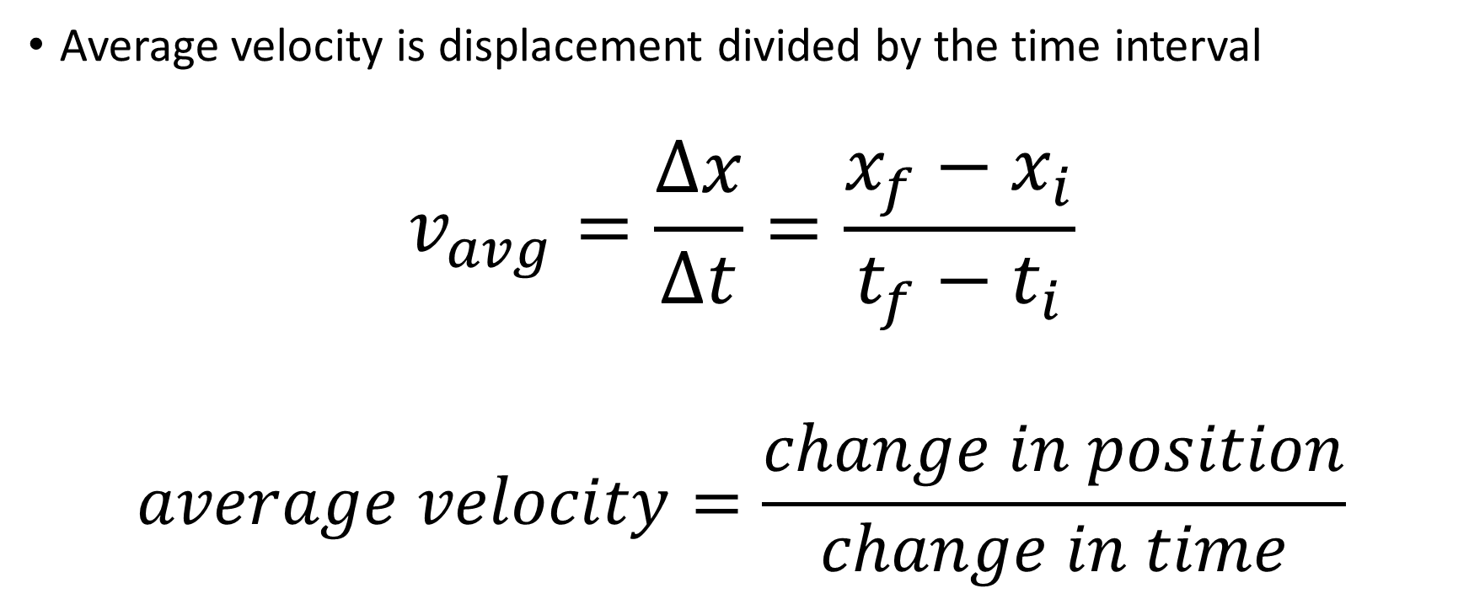
Velocity
Average velocity is displacement divided by the time interval
$$v_{avg}=\frac{Δx}{Δt}=\frac{x_{f}−x_{i}}{t_{f}−t_{i}}$$
$$average velocity=\frac{change in position}{change in time}$$

Slide 6
Velocity
Is not the same as speed.
Can be interpreted graphically.

Slide 7
Instantaneous Velocity
How do we measure it?
Can we determine it from a graph of position and time

