Slide 1
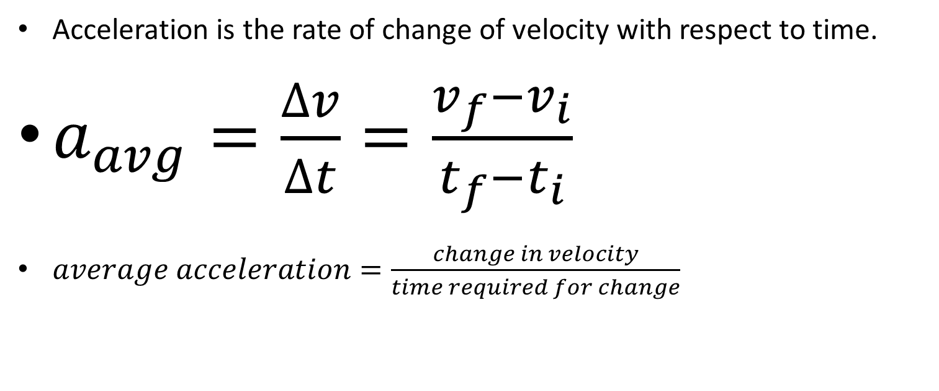
Acceleration
Acceleration is the rate of change of velocity with respect to time.
$a_{avg}=\frac{∆v}{∆t}=\frac{v_{f}−v_{i}}{t_{f}−t_{i}}$
$average acceleration=\frac{change in velocity}{time required for change}$

Slide 2

Units of Acceleration
$a_{avg}= \frac{v_{f}−v_{i}}{t_{f}−t_{i}}$
$a_{avg}= \frac{\frac{m}{s}−\frac{m}{s}}{s−s}=\frac{\frac{m}{s}}{s}=\frac{m}{s^{2}}$

Slide 3
A shuttle bus slows down with an average acceleration of –1.8 m/s2. How long does it take the bus to slow from 9.0 m/s to a complete stop?
What’s the formula to use?
What is given?
What is the unknown that you are trying to determine?
Insert given values in the correct place.
Solve for the unknown.

Slide 4
Acceleration has direction and magnitude
Determine acceleration from the slope and shape of the velocity graph.

Slide 5
Acceleration has direction and magnitude
Increase/decrease in velocity depends on sign of velocity and acceleration
V final | Acceleration | Motion
+ | +
- | -
+ | -
- | +
- or + | 0
0 | - or +
0 | 0

Slide 6
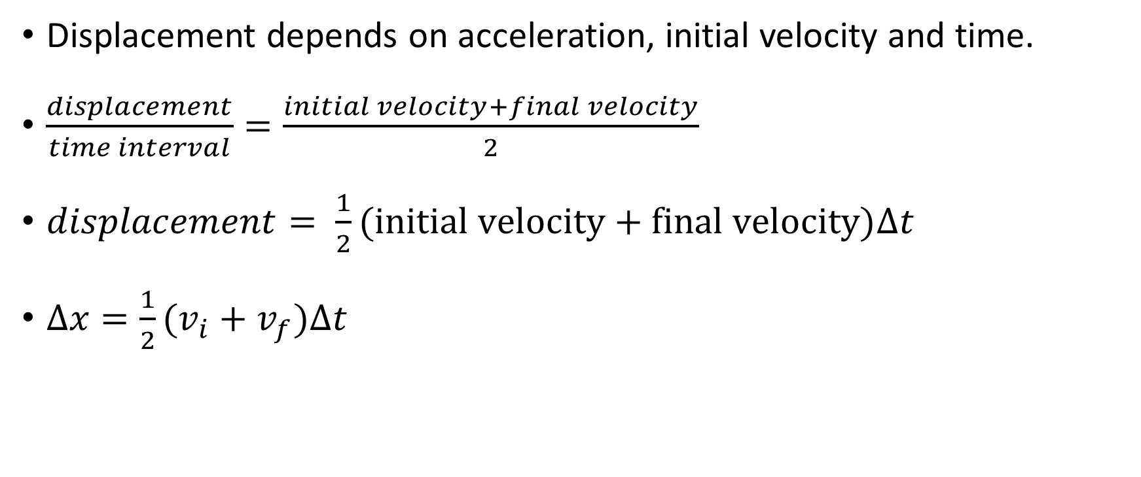
Displacement with Constant Acceleration
Displacement depends on acceleration, initial velocity and time.
$\frac{displacement}{time interval}=\frac{initial velocity+final velocity}{2}$
$displacement= \frac{1}{2}(initial velocity+final velocity)∆t$
$∆x=\frac{1}{2}(v_{i}+v_{f})∆t$

Slide 7
Displacement with Constant Acceleration
A racing car reaches a speed of 42 m/s. It then begins a uniform negative acceleration, using its parachute and braking system, and comes to a rest 5.5 seconds later. Find the distance that the car travels during braking.
What’s the formula to use?
What is given?
What is the unknown that you are trying to determine?
Insert given values in the correct place.
Solve for the unknown.

Slide 8
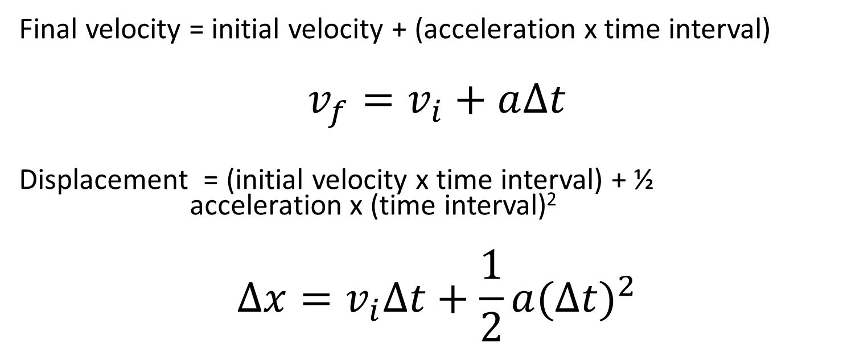
Velocity and Displacement with Constant Acceleration
Final velocity = initial velocity + (acceleration x time interval)
$$v_{f}=v_{i}+a∆t$$
Displacement = (initial velocity x time interval) + ½ acceleration x (time interval)²
$$∆x=v_{i}∆t+\frac{1}{2}a{(∆t)}^{2}$$

Slide 9
Final Velocity after any Displacement
(Final velocity)² = (initial velocity)² + 2(acceleration)(displacement)

