Slide 1
Chapter 2: Newton's
First Law of Motion—Inertia
© 2015 Pearson Education, Inc.

Slide 2
This lecture will help you understand:
Aristotle's Ideas of Motion
Galileo's Concept of Inertia
Newton's First Law of Motion
Net Force and Vectors
The Equilibrium Rule
Support Force
Equilibrium of Moving Things
The Moving Earth

Slide 3
Aristotle's Ideas of Motion
Aristotle's classification of motion
Natural motion
  Every object in the universe has a proper place determined by a combination of four elements: earth, water, air, and fire.
  Any object not in its proper place will strive to get there.
  Examples:
    Stones fall.
    Puffs of smoke rise.

Slide 4
Aristotle's Ideas of Motion, Continued
Natural motion (continued)
  Straight up or straight down for all things on Earth
  Beyond Earth, motion is circular
  Example: The Sun and Moon continually circle Earth
Violent motion
  Produced by external pushes or pulls on objects
  Example: Wind imposes motion on ships.

Slide 5
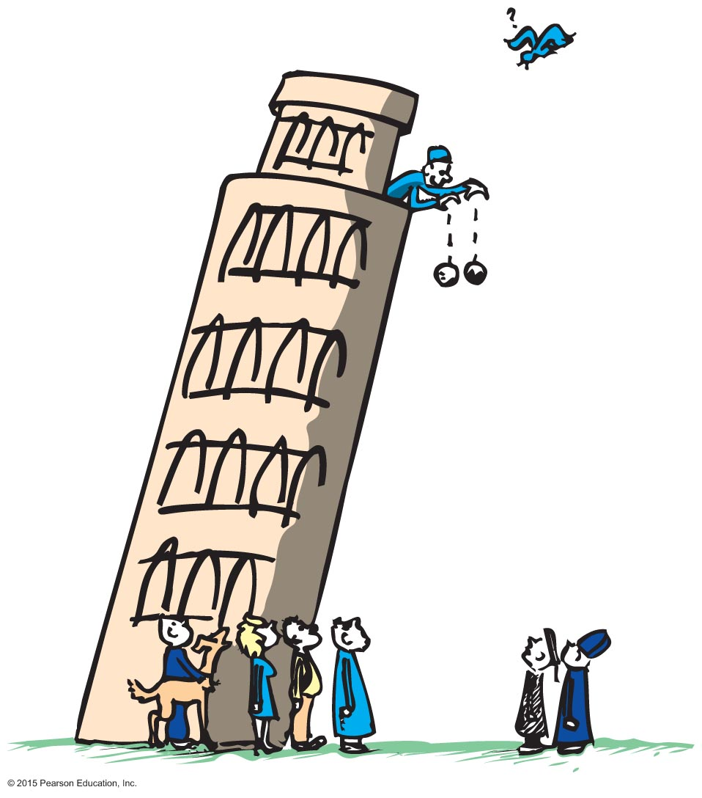
Galileo's Concept of Inertia
Galileo demolished Aristotle's assertions in the 1500s.
Galileo's discovery:
Objects of different weight fall to the ground at the same time in the absence of air resistance.
A moving object needs no force to keep it moving in the absence of friction.

Slide 6
Galileo's Concept of Inertia, Continued
Force
is a push or a pull.
Inertia
is a property of matter to resist changes in motion.
depends on the amount of matter in an object (its mass).

Slide 7
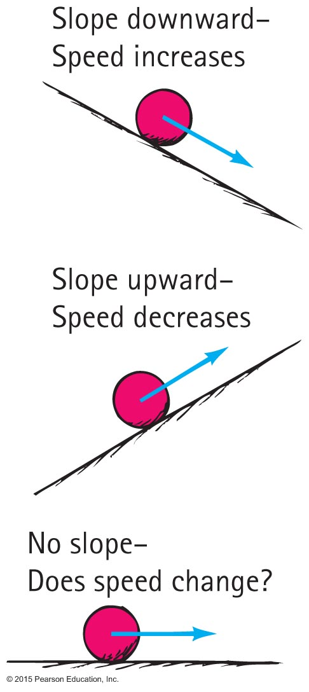
Galileo's Concept of Inertia, Continue-1
Balls rolling on downward-sloping planes pick up speed.
Balls rolling on upward-sloping planes lose speed.
So a ball on a horizontal plane maintains its speed indefinitely.
If the ball comes to rest, it is not due to its "nature," but due to friction.

Slide 8
Galileo's Concept of Inertia
CHECK YOUR NEIGHBOR
The use of inclined planes for Galileo's experiments helped him to
eliminate the acceleration of free fall.
discover the concept of energy.
discover the property called inertia.
discover the concept of momentum
Notes:
8
C. discover the property called inertia.

Slide 9
Galileo's Concept of Inertia
CHECK YOUR ANSWER
The use of inclined planes for Galileo's experiments helped him to
discover the property called inertia.
Comment:
Note that inertia is a property of matter, not a reason for the behavior of matter.
Notes:
9
Inertia is a property of matter.
It is not a reason for the behavior of matter.

Slide 10
Newton's First Law of Motion
Every object continues in a state of rest or of uniform speed in a straight line unless acted on by a nonzero net force.
Notes:
The key word in this law is continues: An object continues to do whatever it happens to be doing unless a force is exerted upon it.
If it is at rest, it continues in a state of rest.
If an object is moving, it continues to move without turning or changing its speed.

Slide 11
Net Force
Vector quantity
a quantity whose description requires both magnitude (how much) and direction (which way)
can be represented by arrows drawn to scale, called vectors
  length of arrow represents magnitude and arrowhead shows direction
  Examples: force, velocity, acceleration

Slide 12
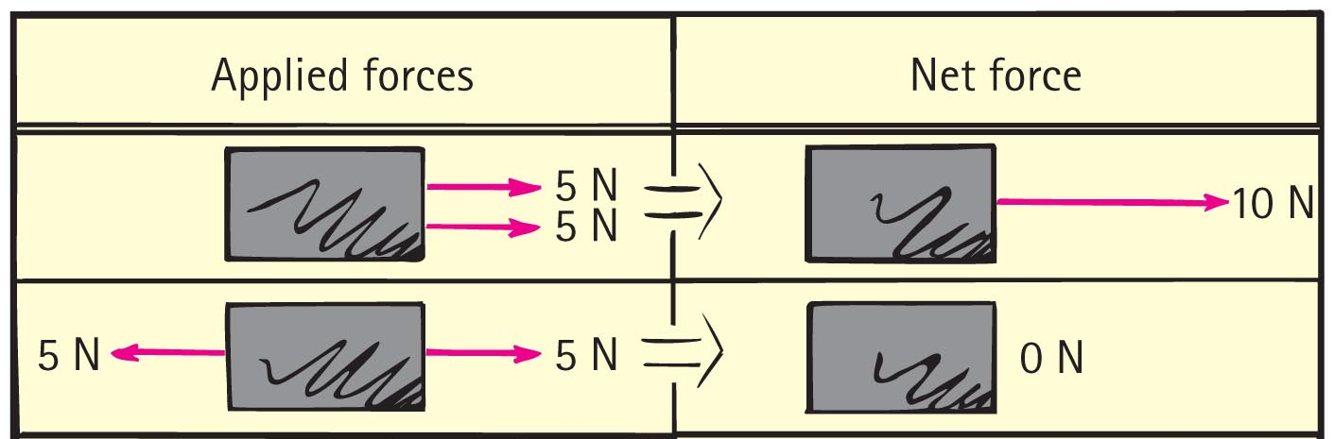
Net Force, Continued
Net force is the combination of all forces that act on an object.
  Example: Two 5-N pulls in the same direction produce a 10-N pull (net force of 10 N). If the pair of 5-N pulls are in opposite directions, the net force is zero.

Slide 13
Net Force
CHECK YOUR NEIGHBOR
A cart is pulled to the right with a force of 15 N while being pulled to the left with a force of 20 N. The net force on the cart is
5 N to the left.
5 N to the right.
25 N to the left.
25 N to the right.
Notes:
13
A. 5 N to the left.

Slide 14
Net Force
CHECK YOUR ANSWER
A cart is pulled to the right with a force of 15 N while being pulled to the left with a force of 20 N. The net force on the cart is
5 N to the left.
The two forces are in opposite directions, so they subtract.
The direction is determined by the direction of the larger force
Notes:
14
When you take a 15-N force to the right added to a 20-N force to the left, because the two forces are in opposite directions, they in fact subtract, rather than add.
So, the larger 20-N force to the left is cut back by the 15-N force to the right, so that the remaining force, that is, the net force, is only 5 N to the left.

Slide 15
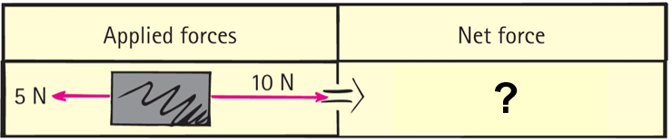
Net Force
CHECK YOUR NEIGHBOR, Continued
What is the net force acting on the box?
15 N to the left
15 N to the right
5 N to the left
5 N to the right
Notes:
15
D. 5 N to the left

Slide 16
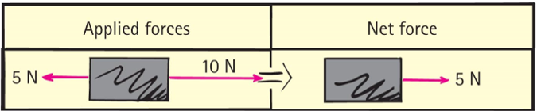
Net Force
CHECK YOUR ANSWER, Continued
What is the net force acting on the box?
5 N to the right
Notes:
16
When you take a 10-N force to the right added to a 5-N force to the left, because the two forces are in opposite directions, they in fact subtract, rather than add.
So, the larger 10-N force to the right is cut back by the 5-N force to the left, so that the remaining force, that is, the net force, is only 5 N to the right.

Slide 17
Vectors
Vector quantity
has magnitude and direction.
is represented by an arrow.
Example: velocity, force, acceleration
Scalar quantity
has magnitude.
Example: mass, volume, speed

Slide 18
Vectors, Continued
Resultant
The sum of two or more vectors
  For vectors in the same direction, add arithmetically.
  For vectors in opposite directions, subtract arithmetically.
  Two vectors that don't act in the same or opposite direction:
    use parallelogram rule.
  Two vectors at right angles to each other
    use Pythagorean Theorem:

Slide 19
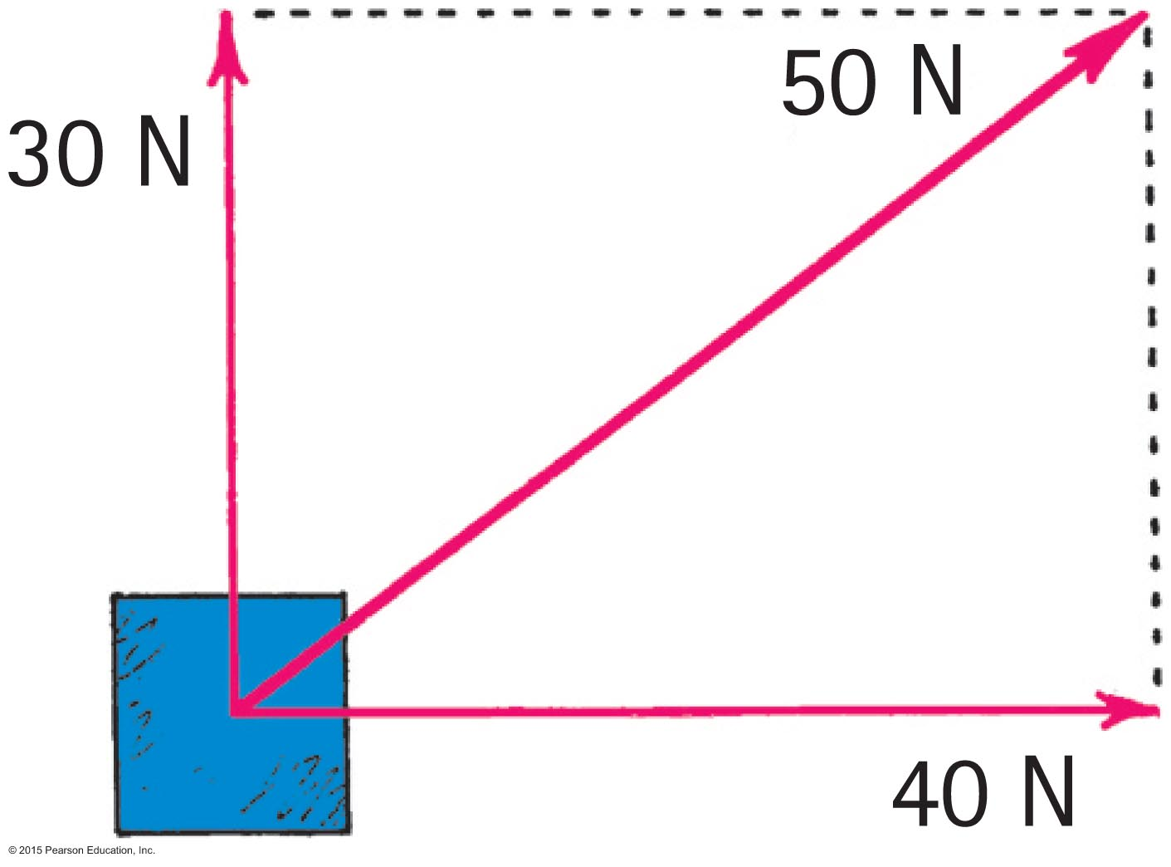
Vectors
CHECK YOUR NEIGHBOR
Referring to the figure, which of the following are true statements?
50 N is the resultant of the 30- and the 40-N vectors.
The 30-N vector can be considered a component of the 50-N vector.
The 40-N vector can be considered
a component of the 50-N vector.
All of the above are correct.
Notes:
D. All of the above are correct.

Slide 20
Vectors
CHECK YOUR ANSWER
Referring to the figure, which of the following are true statements?
All of the above are correct.
Notes:
D. All of the above are correct.

Slide 21
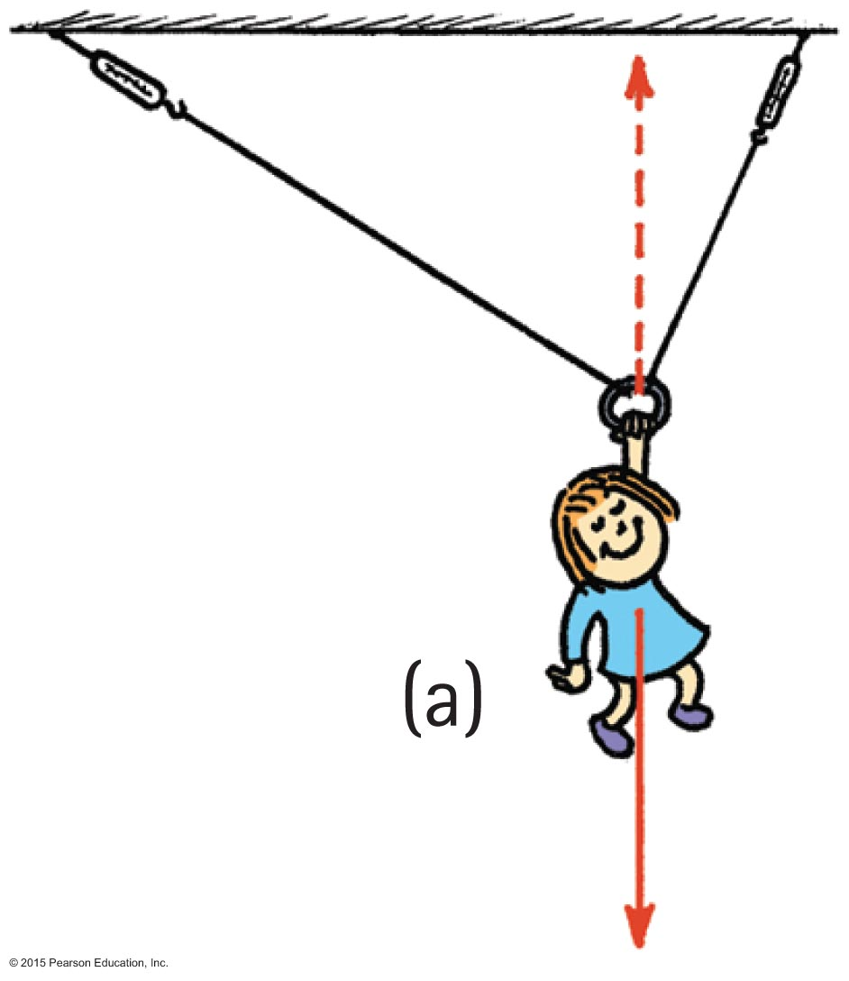
Vectors, Continue-1
Nellie Newton hangs from a rope
as shown.
Which side has the greater tension?
There are three forces acting on Nellie:
  her weight, mg,
  a tension in the left-hand side of the rope,
  and a tension in the right-hand side of the rope.

Slide 22
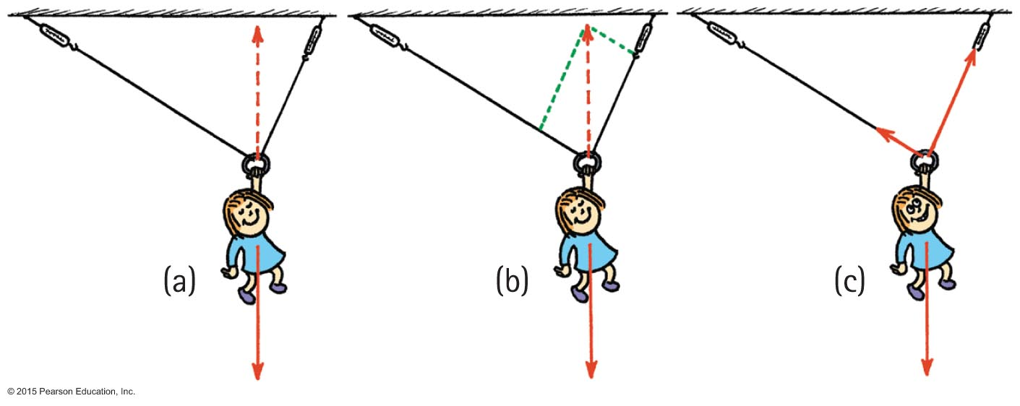
Vectors, Continue-2
Because of the different angles, different rope tensions will occur in each side.
Nellie hangs in equilibrium, so her weight is supported by two rope tensions, adding vectorially to be equal and opposite to her weight.
The parallelogram rule shows that the tension in the right-hand is greater than the tension in the left-hand side of the rope.

Slide 23
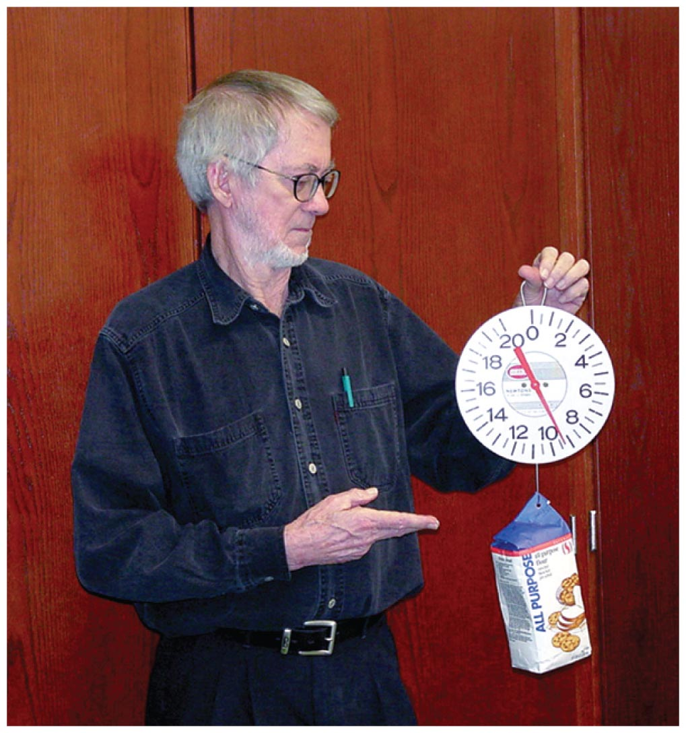
The Equilibrium Rule: Example
A string holding up a bag of flour
Two forces act on the bag of flour:
  Tension force in string acts upward.
  Force due to gravity acts downward.
Both are equal in magnitude and opposite in direction.
  When added, they cancel to zero.
  So, the bag of flour remains at rest.

Slide 24
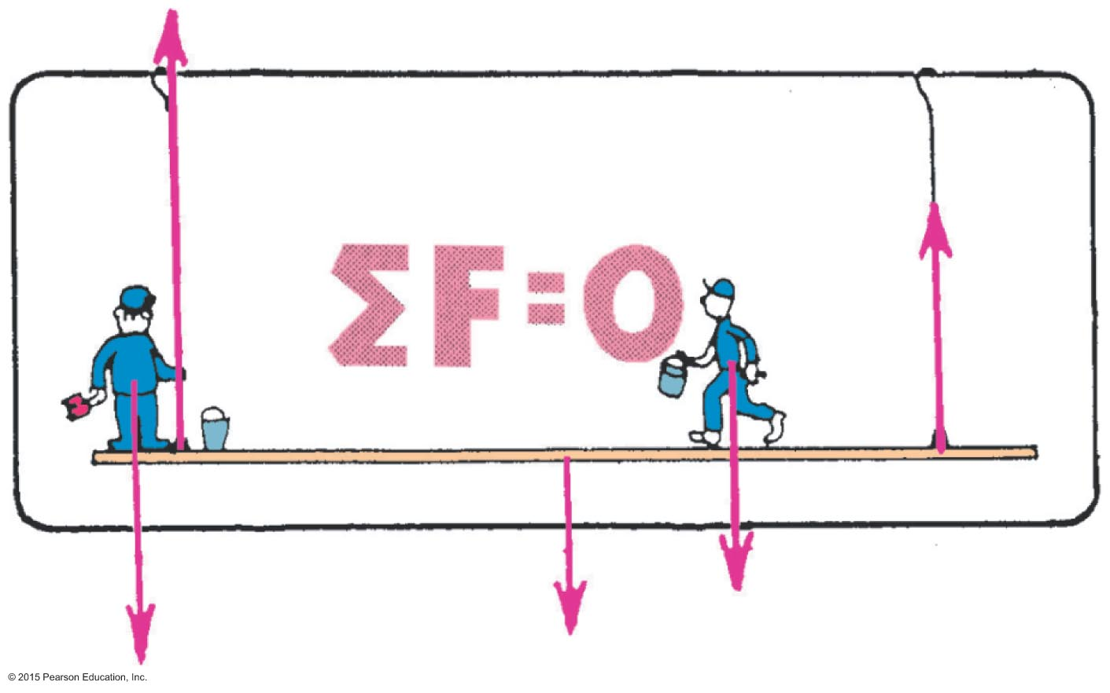
The Equilibrium Rule
The vector sum of forces acting on a nonaccelerating object equals zero.
In equation for:
  The red arrows represent force vectors. The sum of the two upward force vectors minus the sum of the three bottom force vectors, equals zero. We say the forces cancel to zero, and the system of Burl, Paul, and the staging is in equilibrium.

Slide 25
The Equilibrium Rule
CHECK YOUR NEIGHBOR
The equilibrium rule,
, applies to
vector quantities.
scalar quantities.
Both of the above.
None of the above.
Notes:
25
A. vector quantities.

Slide 26
The Equilibrium Rule
CHECK YOUR ANSWER
The equilibrium rule,
, applies to
vector quantities.
Explanation:
Vector addition accounts for + and - quantities. So, two vectors in opposite directions can add to zero.
Notes:
26
Vector addition takes into account the signs of quantities. So quantities, such as forces can be either positive or negative. In this way, two forces (forces), one positive and the other negative, can add to zero. But there is no way that two masses (scalars) can add to zero.

Slide 27
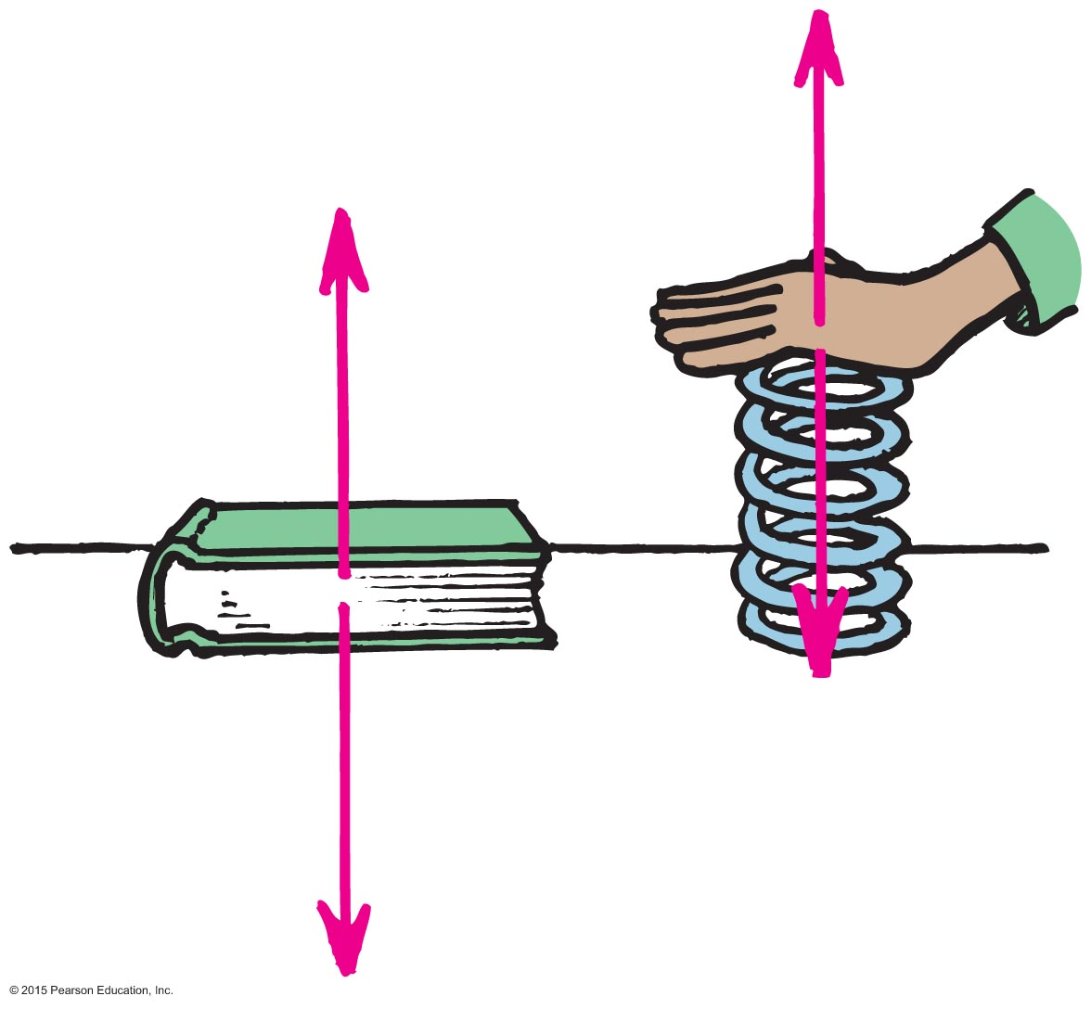
Support Force
Support force (normal force) is an upward force on an object that is opposite to the force of gravity.
Example: A book on a table compresses
atoms in the table, and the compressed
atoms produce the support force.

Slide 28
Understanding Support Force
When you push down on a spring, the spring pushes back up on you.
Similarly, when a book pushes down on a table, the table pushes back up on the book.

Slide 29
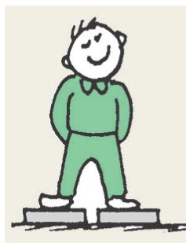
Support Force
CHECK YOUR NEIGHBOR
When you stand on two bathroom scales with one foot on each scale and with your weight evenly distributed, each scale will read
your weight.
half your weight.
zero.
more than your weight.
Notes:
29
B. half your weight.

Slide 30
Support Force
CHECK YOUR ANSWER
When you stand on two bathroom scales with one foot on each scale and with your weight evenly distributed, each scale will read
half your weight.
Explanation:
You are at rest, so
Forces from both scales add to cancel your weight.
Force from each scale is one-half your weight.
Notes:
30
You are at rest on the scales, so ΣF = 0. The sum of the two upward support forces is equal to your weight.
Your weight is distributed over the two scales. So, each scale reads half your weight.

Slide 31
Equilibrium of Moving Things
Equilibrium: a state of no change with no net force acting
  Static equilibrium
  Example: hockey puck at rest on slippery ice
  Dynamic equilibrium
  Example: hockey puck sliding at constant
  speed on slippery ice

Slide 32
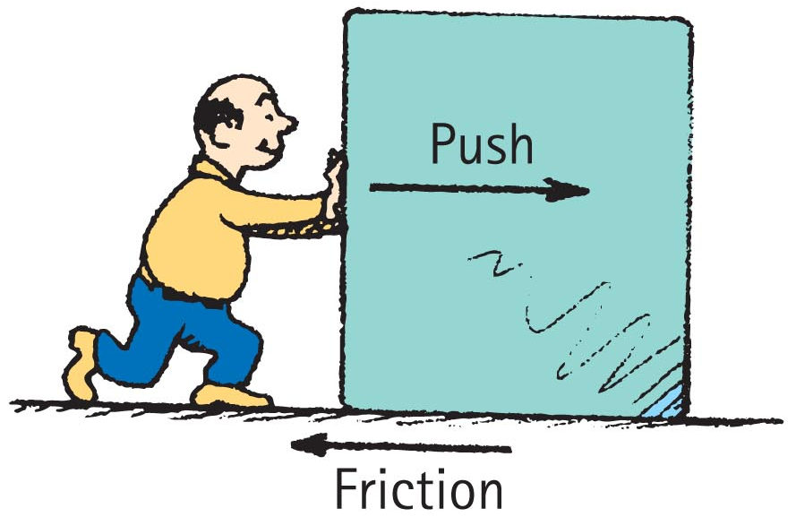
Equilibrium of Moving Things, Continued
Equilibrium test: whether something undergoes change in motion
  Example: A crate at rest is in static equilibrium (no change in motion).
  Example: When pushed at a steady speed, it is in dynamic equilibrium (no change in motion).

Slide 33
Equilibrium of Moving Things
CHECK YOUR NEIGHBOR
A bowling ball is in equilibrium when it
is at rest.
moves steadily in a straight-line path.
Both of the above.
None of the above.
Notes:
33
C. Both of the above.

Slide 34
Equilibrium of Moving Things
CHECK YOUR ANSWER
A bowling ball is in equilibrium when it
Both of the above.
Explanation:
Equilibrium means no change in motion, so there are two options:
If at rest, it continues at rest.
If in motion, it continues at a steady rate in a straight line.
Notes:
34
For an object to be in equilibrium, it does not necessarily have to be at rest.
It can be in equilibrium as long as it is not changing its motion.
If it is initially at rest it must continue to remain at rest.
If it is initially in motion it must continue in motion at a steady rate in a straight-line path.

Slide 35
Equilibrium of Moving Things
CHECK YOUR NEIGHBOR, Continued
You push a crate at a steady speed in a straight line. If the friction force is 75 N, how much force must you apply?
More than 75 N.
Less than 75 N.
Equal to 75 N.
Not enough information.
Notes:
35
C. equal to 75 N

Slide 36
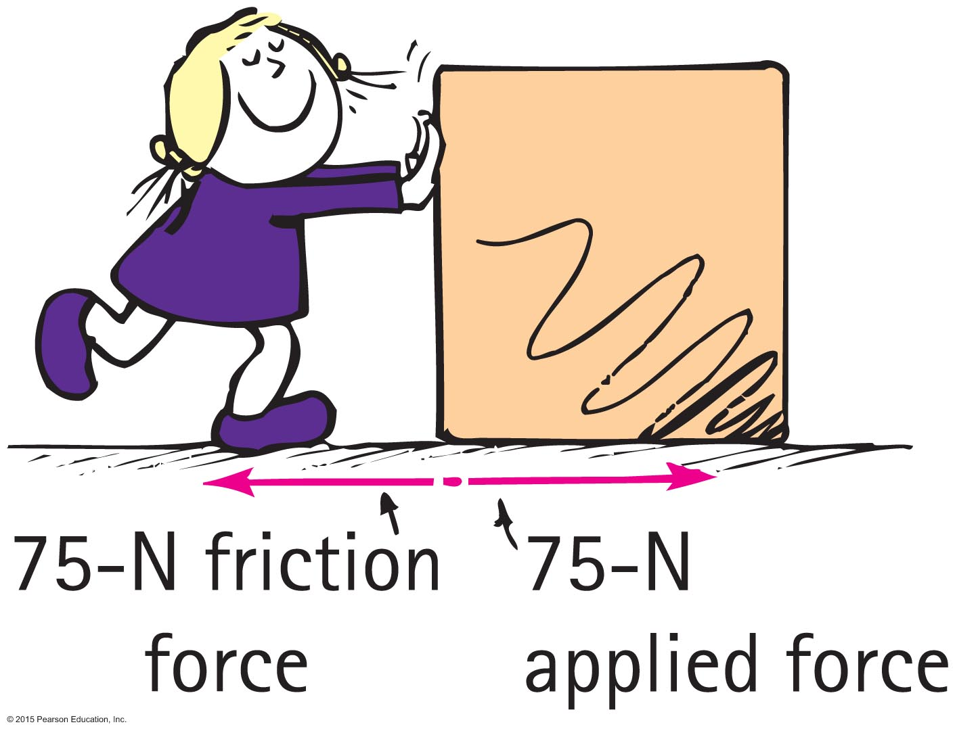
Equilibrium of Moving Things
CHECK YOUR ANSWER, Continued
You push a crate at a steady speed in a straight line. If the friction force is 75 N, how much force must you apply?
Equal to 75 N.
Explanation:
The crate is in dynamic equilibrium, so,
Your applied force balances the force of friction.
Notes:
36
The crate is in dynamic equilibrium. So there is no NET force acting on it.
So you must apply a force that balances out the force of friction. Which means it must be equal and opposite to the force of friction. So if Friction is 75 N to the left, the Applied Force from you is 75 N to the right.

Slide 37
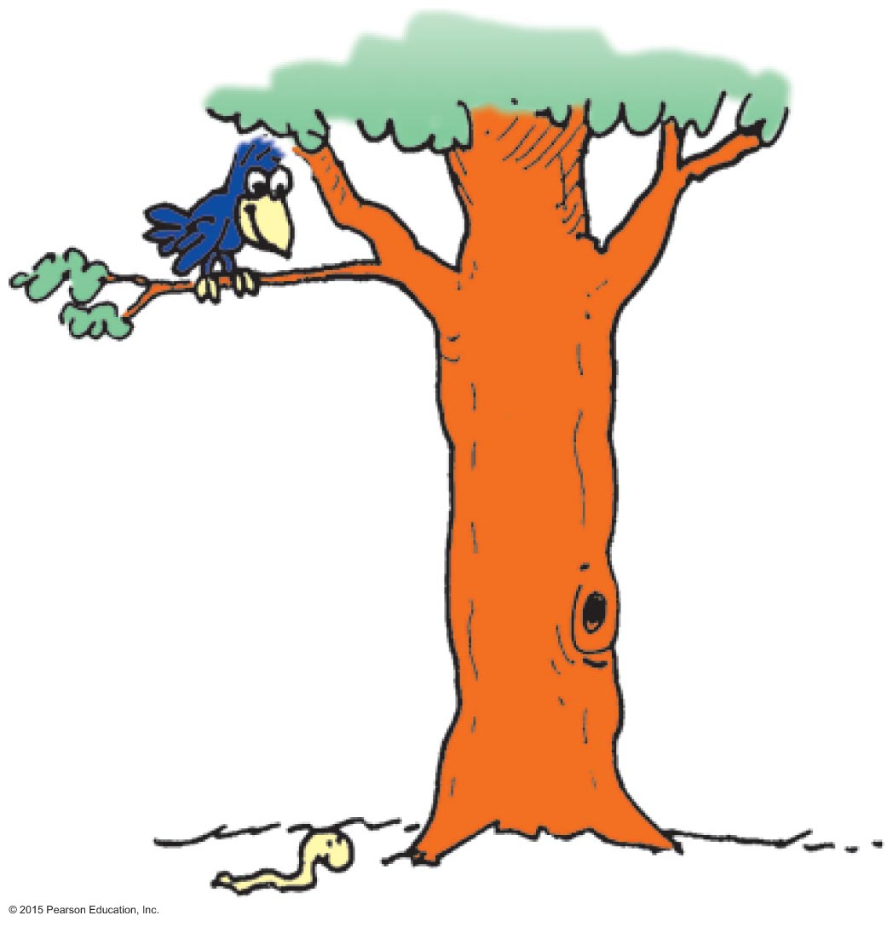
The Moving Earth
Copernicus proposed that Earth was moving, circulating the Sun.
This idea was refuted by people.
Example: If Earth moved, how could a bird swoop from a branch to catch a worm?
Solution: As it swoops, due to inertia, it continues to move sideways at the speed of Earth along with the tree, worm, etc.

Slide 38
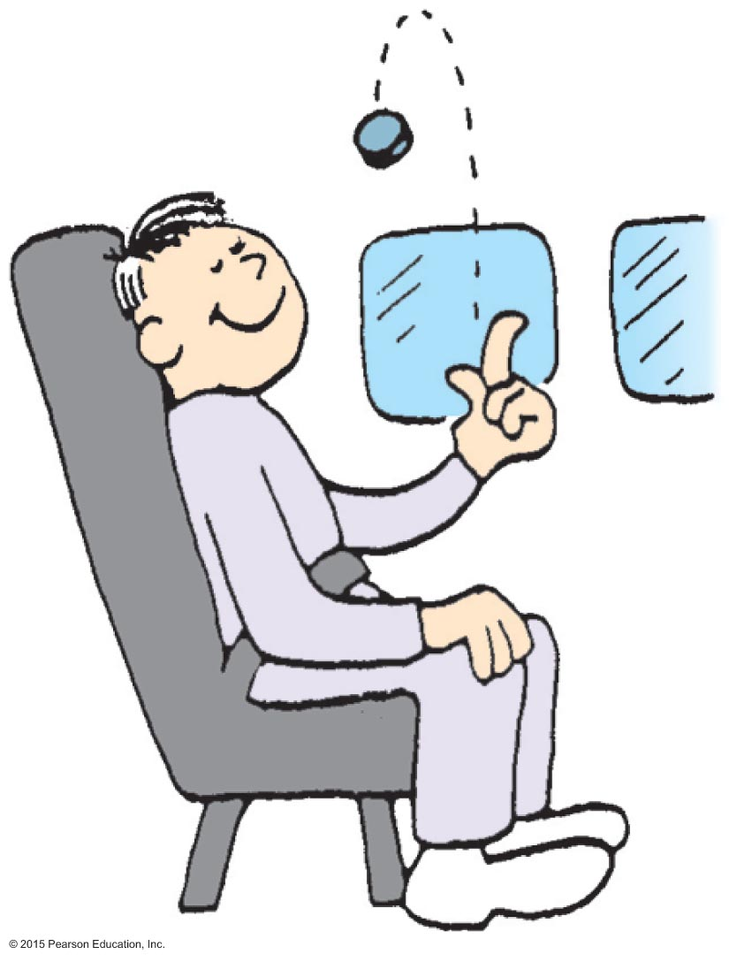
The Moving Earth
CHECK YOUR NEIGHBOR
You are riding in a vehicle at a steady speed and toss a coin straight upward. Where will the coin land?
Behind you.
Ahead of you.
In your hand.
There is not enough information.
Notes:
38
C. in your hand

Slide 39
The Moving Earth
CHECK YOUR ANSWER
You are riding in a vehicle at a steady speed and toss a coin straight upward. Where will the coin land?
In your hand.
Explanation:
Due to the coin's inertia, it continues sideways with the same speed as the vehicle in its up-and-down motion, which is why it lands in your hand.
Notes:
39
C. in your hand

